Slide 1
GNU/Linux System Support
CST8207
Week-2, L-1
Sep 15, 2025
By: Gurpreet Singh Sidhu

Slide 2
Topics
Path Simplification
Basename
Manual page (man)
Directories (ROOT, root, HOME, home)
Shell basics

Slide 3
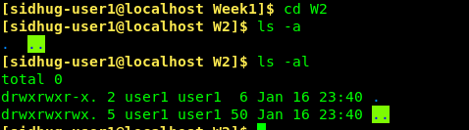
Dot and Dot Dot – . and ..
Every Unix directory contains two special names that you can’t change and can’t remove:
Every Unix directory contains the name . (dot), which is a name that leads right back to the directory in which it is found.
Every directory contains the name .. (dot dot), which is a name that leads to the unique parent directory of the directory in which it is found.

Slide 4
Simplify the pathnames
/home/me/../you/../../etc/../home/me/../you/../me/../foo = /home/foo
/home/me/../you/../../etc/../home/me/../you/../me/../.. = /
/usr/./bin/../lib/../../etc/../usr/./lib/../bin/./bar =
/usr/./bin/../lib/../../etc/../usr/./lib/../bin/.. =
/../../var/./a/../../var/b/../../etc/./bar/../foo = /etc/foo
/../../var/./a/../../var/b/../../etc/./bar/.. =
/

Slide 5
Challenge - Question 1
If I am in a directory named /home/me and tim is an empty sub directory, what is true after this command line:
touch fil ; mv tim/../fil ../me/cat
a. there is a second copy of the file fil in the file named cat
b. the directory tim now contains only a file named cat
c. the command fails because the path tim/../fil does not exist
e. the directory tim/.. now has a file named cat in it
d none of above

Slide 6
Basename
The basename of any pathname is its right-most name component, to the right of its right-most slash.
Example:
pathname /home/user/file has a basename of file
pathname /usr/lib/file has a basename of file
pathname /etc/file has a basename of file
pathname /bin/grep has a basename of grep
pathname /bin/grep has a basename of grep
pathname ./grep has a basename of grep
pathname grep has a basename of grep
pathname bin/. has a basename of .
pathname /etc/.. has a basename of ..
pathname lib/ has a basename lib

Slide 7
Directories: ROOT, /root, HOME, /home, and current
The ROOT directory /
The nameless directory at the top of the Unix/Linux/BSD/OSX file system tree.
The directory named /root
The personal HOME directory of the root account on many systems.
This is the HOME directory where root is placed when root logs in to the system as a user.

Slide 8

Directories: ROOT, /root, HOME, /home, and current
Your HOME directory
The directory given to you by the system administrator and into which you are placed when you first log in, e.g: /home/user1
Created when a user account is created.
Your HOME directory is the usual place to store your files.
This is the directory you go to when you type cd with no arguments.
You own this directory, and therefore you can change its permissions.
user’s home directory is designated as (~)

Slide 9
Directories: ROOT, /root, HOME, /home, and current
The directory named /home
/home is NOT your HOME directory; it is usually a system directory named /home.
/home is a system directory; you do not own it and you cannot change it.
Usually the directory named /home contains all the user HOME directories, e.g. /home/sofia, /home/jonathan, etc.

Slide 10
Directories: ROOT, /root, HOME, /home, and current
The “current directory”
Also called the “current working directory” or “working directory”.
This is the directory that your shell (or any Unix/Linux process) is currently in.
The current directory of a shell can be changed by using the cd command.
A name for the current directory is always . (dot)

Slide 11
Basic Commands
ls – list all directories within the current directory
Cd – change directory
man - manual
Cat- display the files contents
Pwd – display current directory
cp - copy
Mv – move or rename
Rm- remove
Rmdir – remove director
Mkdir – make directory
Echo – print a string from the command or print the value of a variable
Touch – create a file

Slide 12
Finding Help in Manual Pages
Unix-like operating systems – including Linux – have command-line help files called “man pages” (manual pages).
The usual way to access to man pages is via the man command.
When you type man something at a Linux shell prompt, the pages of the manual are displayed one-at-a-time using a standard “pagination” program named less. For example, try:

Slide 13
Searching for text within a manual page
Manual pages are usually paginated using a standard pagination program such as less, you can use all the features of the pagination program to search inside the manual page, including the text search feature that is usually bound to the slash key /.
For example, bring up the man page for the ls command (man ls) and then at the manual page prompt at the bottom of your screen search for the three words long listing format by typing a slash followed by the words you want to search for, followed by the ENTER key:
You can use the n key to repeat a search if the first thing you find isn’t what you are looking for. Try searching for the word file and use the n key repeatedly to find each line containing the word.

Slide 14
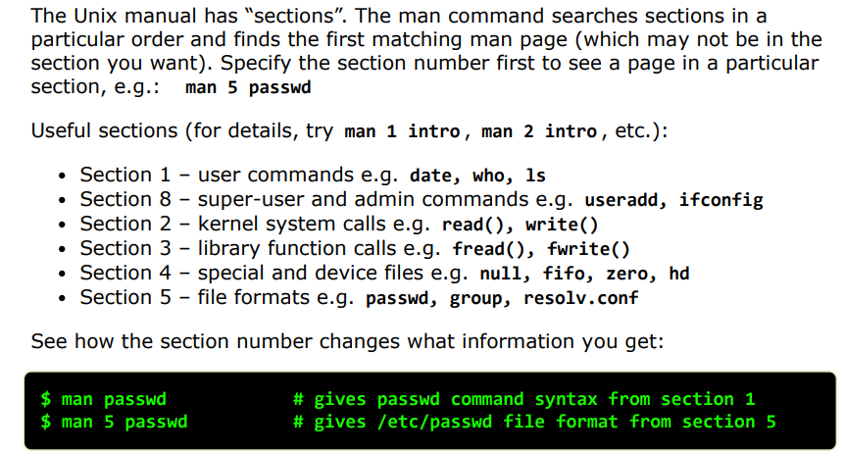
Manual has Sections

Slide 15
Reading manual pages SYNOPSIS Line(s)
To understand how to read the syntax of the SYNOPSIS section of a manual page, see the following conventions lines in the DESCRIPTION section of the man page for the man command. Using man man you can learn what conventions apply to the SYNOPSIS section. (You can search for following conventions in the man page.)
Answer these questions about the SYNOPSIS section of a man page:
What does bold text mean? Type exactly as shown
What does italic (underlined, on terminals) text mean? Replace with appropriate argument
What do square brackets [ ] around something mean? The enclose argument is optional
What does the pipe or OR-bar symbol | (SHIFT-\) mean? It allows for the input of a second command
What do three dots (ellipsis) ... mean? The proceeding argument or expression can be repeated one or more times

Slide 16
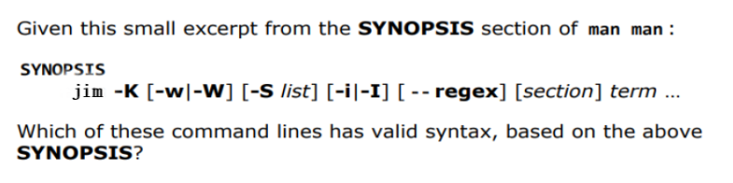
Exercise: reading the SYNOPSIS section (Home work)
jim foo
jim 3 foo
jim -K foo
jim -K -w -W foo
jim -K -w foo
jim -K -W foo
jim -K -S foo
jim -K -S 1,2,3 foo
jim -K -i -I foo
jim -K -W -i foo
jim -K --regex foo
jim -K --regex 3 foo
jim -K -w -I --regex 3 foo
jim -K -w -S 1,2,3 -W -i -I --regex 3 foo

Slide 17
Shell Basics

Slide 18
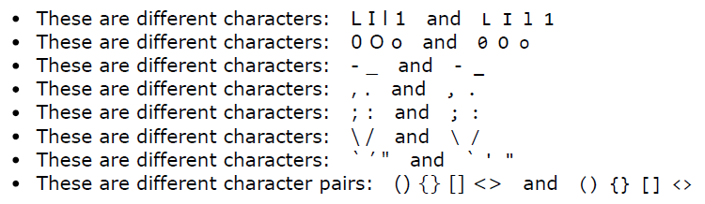
Characters that Look the Same but are Different
You must pay strict attention to the exact characters used in command lines. Here are some common confusions,
shown in two font styles:
A common error is to think that the option letter l after the dash in ls -l is the digit 1. It’s a letter l, not a digit1.

Slide 19
Special Characters
Special characters, which have a special meaning to the shell, These characters are mentioned here so that you can avoid accidentally using them as regular characters until you understand how the shell interprets them.
For example, it is best to avoid using any of the following characters in a filename because they make the file harder to reference on the command line:
& ; | * ? ' " ‘ [ ] ( ) $ < > { } # / \ ! ~
If you need to use a character that has a special meaning to the shell as a regular character, you can quote (or escape) it. When you quote a special character, you keep the shell from giving it special meaning. The shell treats a quoted special character as a regular character. However, a slash (/) is always a separator in a pathname, even when you quote it.

Slide 20
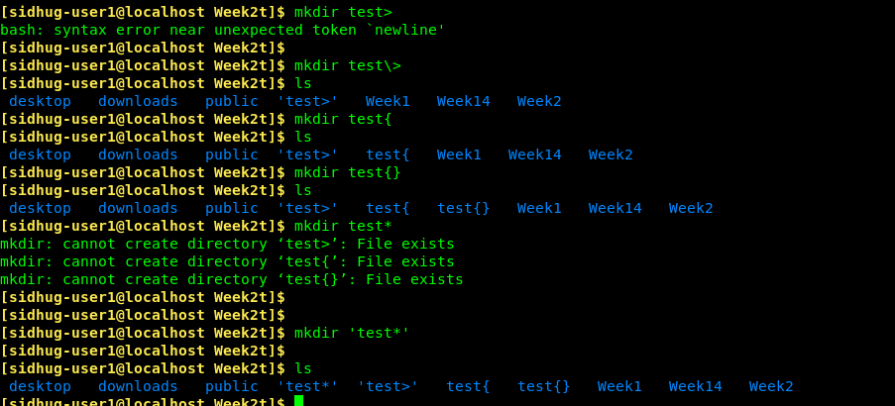
Special Characters
Another way of quoting special characters is to enclose them between single quotation marks: ' **'. You can quote many special and regular characters between a pair of single quotation marks.

Slide 21
Syntax of Control Characters – ^A ^B ^C etc.
^C - CTRL-C - *interrupt* (terminate) a running foreground program
^D - CTRL-D - send *End-of-File* (EOF) from your keyboard (end input)
^U - CTRL-U - erase input characters back to the start of the prompt
^W - CTRL-W - erase just the last word you typed (repeat to erase next word)
^Z - CTRL-Z - temporarily *suspend* a program; restart by typing "fg“
^B - CTRL-B – go left one character
^A - CTRL-A – go to the beginning of the line
^L - CTRL-L – clear your screen; move current command line to top

Slide 22
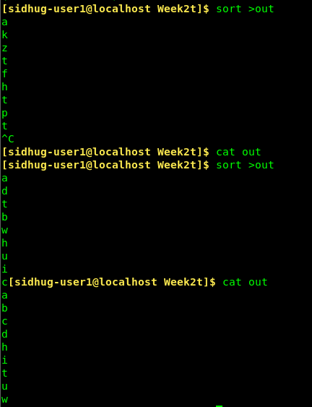
Examples of ^C and ^D
Here is an example showing how ^C interrupts a program before it finishes, but ^D signals an EOF and lets the program finish. In both examples below we use shell Output Redirection to save the output of the sort command into a file named out:

Slide 23
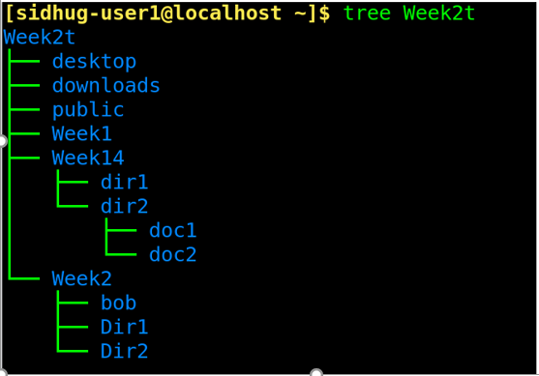
Example for { }
mkdir -p desktop downloads public Week1 Week2/{Dir1,Dir2,bob} Week14/{dir1,dir2/{doc1,doc2}}

Slide 24
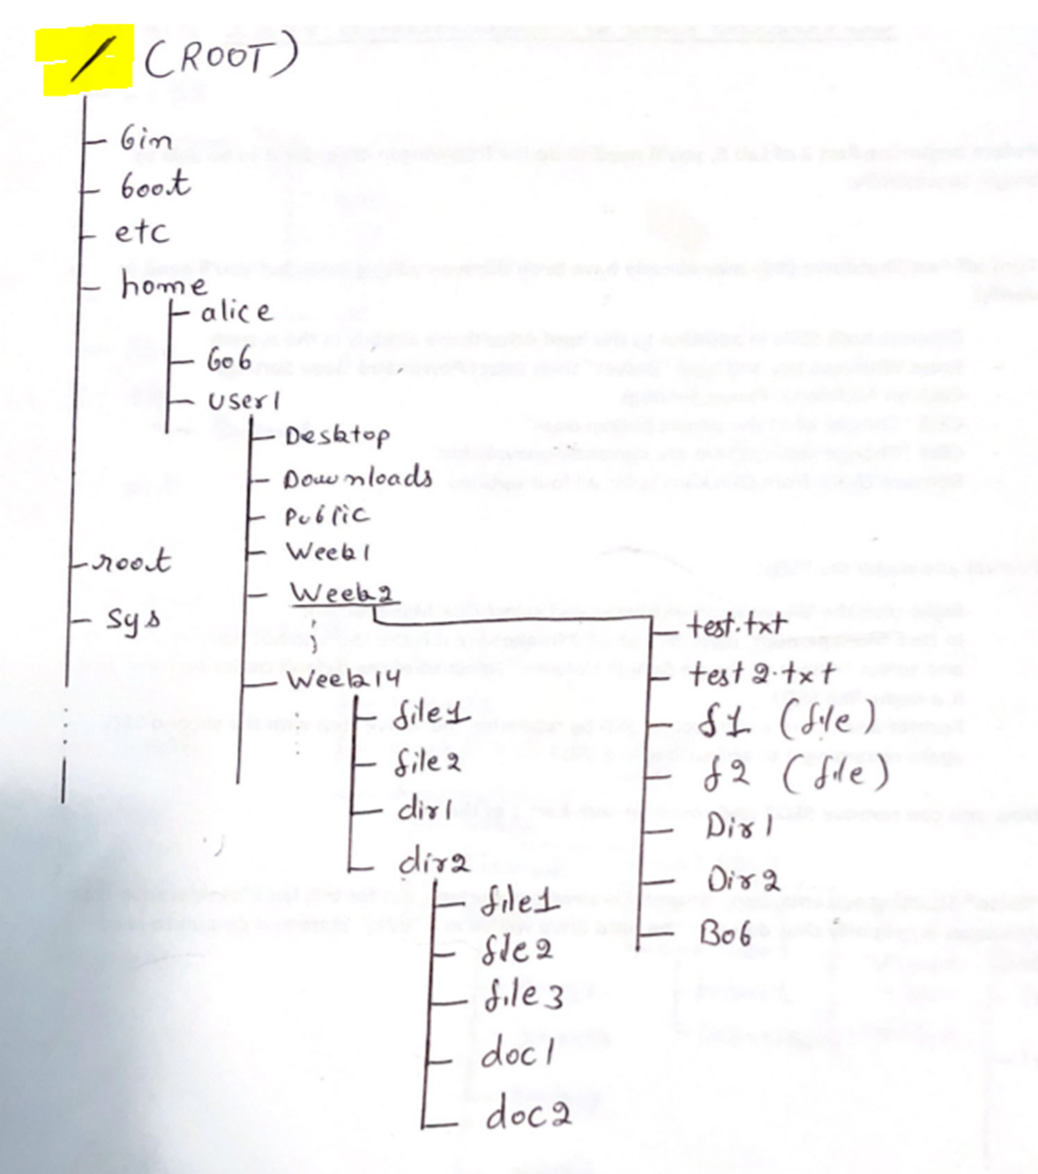
Practice

